Slide 1


Slide 2
PREVIEW
Analytical Approach
Individual assessment charts
Free Learning material (incl access to additional resources for overall devp in Academic Perspectives)
Formulae Charts & Work Sheets
Periodical Assessment Tests
Emphasis Areas & Scope refinement
Mock Tests
Revision Sessions

Slide 3
TUTORING PATTERNS
Chapter-wise Tests
Calibration Tests
Mock Tests
Assessment Tests
Pre-Final / Final Tests
Formulae Sheets
Revision Notes

Slide 4
SUBJECT OVERVIEW

Slide 5
66 days
30 days
23 days
45 days
43 days
10 days
7 days
8 days
1 day
Level-1
Apr 1 - Jul 1
Schedule : 2022-23
Term Break -A
May 15 - Jun 15
2022
Jul 15 - Sep 15
Level-2
Term Break-B
Oct 2 - Oct 11
Level-3
Oct 12 - Dec 10
Term Break-C
Dec 24 - Jan 4
Level-4
Jan 5 - Feb 15
Revision Sessions
Feb 16 - Mar 1
Calibration Test
Mar 2 - Mar 5
Commencement of classes
Apr 1
Feb
Apr
Jun
Aug
Oct
Dec
Feb
2023
Today
Registrations Window
Feb 15
Admissions
Orientation Session
Mar 27
Mar 30
Zero Test for Foundation
Jul 1
Assessment : Level-1
Assesments
Sep 16
Assessment : Level-2
Dec 15
Assessment : Level-3
Feb 16
Assessment : Level-4
Mock Tests
Pre-Finals
Feb 28
Finals
Mar 3

Slide 6
PERFORMANCE ANALYSIS

Slide 7
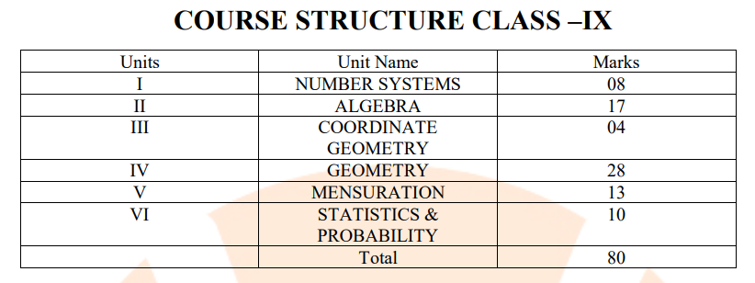
SYLLABUS
Class - VIII
Ser | Chapters
I | Rational Numbers
II | Linear Equations in one variable
III | Understanding quadrilaterals
IV | Practical Geometry
V | Data Handling
VI | Squares,Cubes, Cube roots
VII | Algebraic expression & Identities
VIII | Mensuration
IX | Direct & Inverse Proportions
X | Factorisation
Class - VII
Ser | Chapters
I | Fractions & Decimals
II | Simple Equations
III | Data Handling
IV | Triangle & Properties
V | Congruence of Triangles
VI | Comparing quantities
VII | Practical Geometry
VIII | Perimeter & Area
IX | Algebraic Expressions
X | Exponents & Powers

Slide 8
SYLLABUS
Class 6 – Mathematics - Syllabus Mathematics
Chapter 1: Knowing our Numbers • Comparing Numbers
Chapter 2: Whole Numbers • Whole Numbers • The Number Line • Properties of Whole Numbers • Patterns in Whole Numbers
Chapter 3: Playing with Numbers • Factors and Multiples • Prime and Composite Numbers • Tests for Divisibility of Numbers • Common Factors and Common Multiples • Some More Divisibility Rules • Prime Factorisation • Highest Common Factor • Lowest Common Multiple • Some Problems on HCF and LCM
Chapter 4: Basic Geometrical Ideas • Points • A Line Segment • A Line • Intersecting Lines • Parallel Lines • Ray • Curves • Polygons • Angles • Triangles • Quadrilaterals • Circles
Chapter 5: Understanding Elementary Shapes • Measuring Line Segments • Angles – ‘Right’ and ‘Straight’ • Angles – ‘Acute’, ‘Obtuse’ and ‘Reflex’ • Measuring Angles • Perpendicular Lines • Classification of Triangles • Quadrilaterals • Polygons • Three Dimensional Shapes
Chapter 6: Integers • Integers • Addition of Integers • Subtraction of Integers with the help of a Number Line
Chapter 7: Fractions • A Fraction • Fraction on the Number Line • Proper Fractions • Improper and Mixed Fractions • Equivalent Fractions • Simplest Form of a Fraction • Like Fractions • Comparing Fractions • Addition and Subtraction of Fractions
Chapter 8: Decimals • Tenths • Hundredths • Comparing Decimals • Using Decimals • Addition of Numbers with Decimals • Subtraction of Decimals
Chapter 9: Data Handling • Recording Data • Organisation of Data • Pictograph • Interpretation of a Pictograph • Drawing a Pictograph • A Bar Graph
Chapter 10: Mensuration • Perimeter • Area
Chapter 11: Algebra • Matchstick Patterns • The Idea of a Variable • More Matchstick Patterns • More Examples of Variables • Use of Variables in Common Rules • Expressions with Variables • Using Expressions Practically • What is an Equation? • Solution of an Equation
Chapter 12: Ratio and Proportion • Ratio • Proportion • Unitary Method
Chapter 13: Symmetry

Slide 9
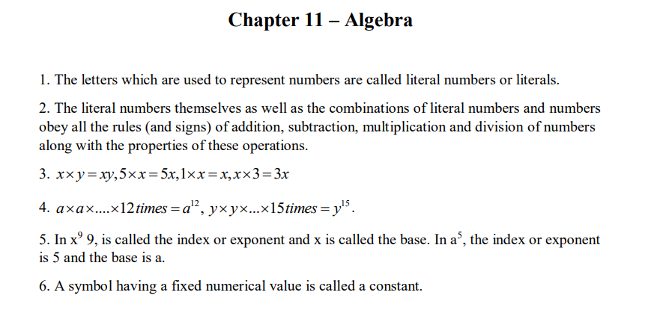
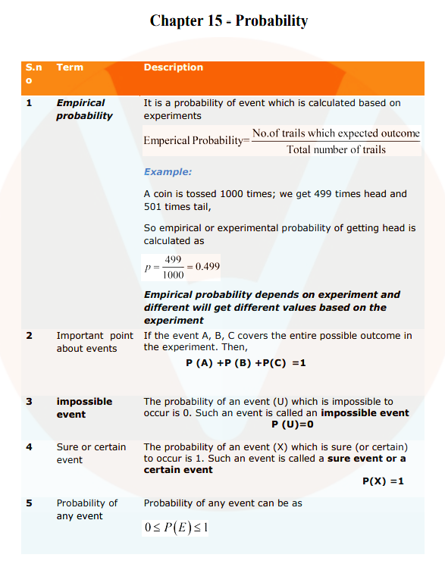
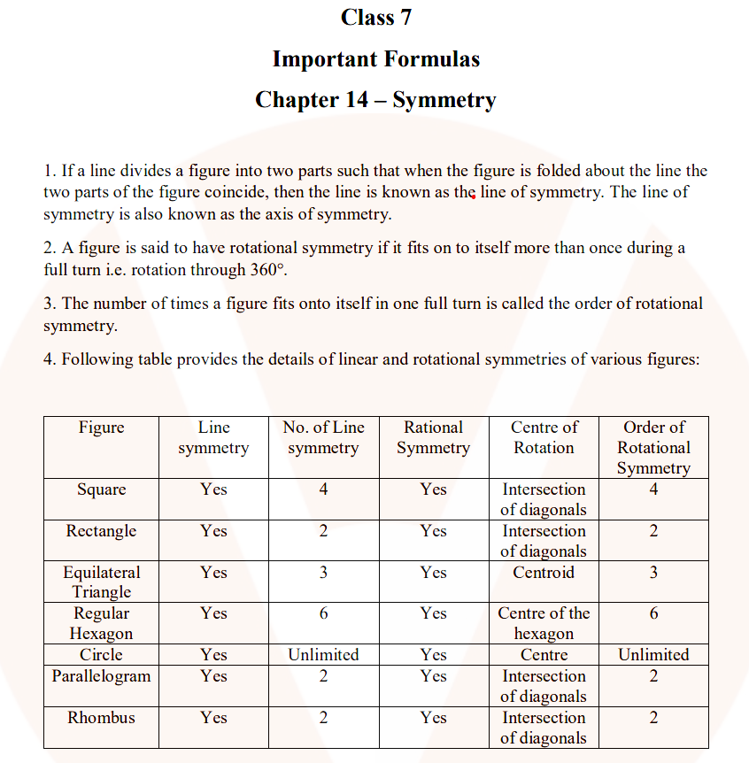
FORMUALE CHARTS

Slide 10
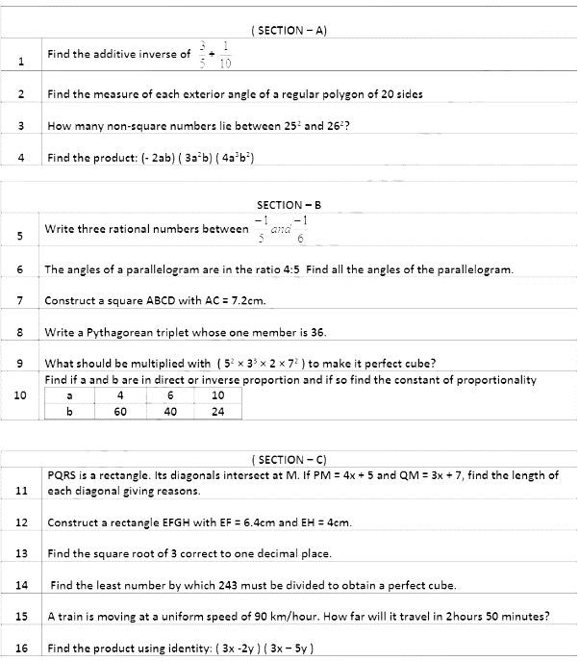
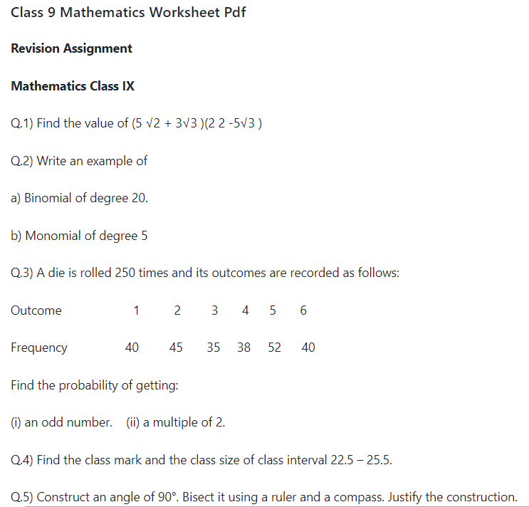
PRACTICE SHEETS

Slide 11
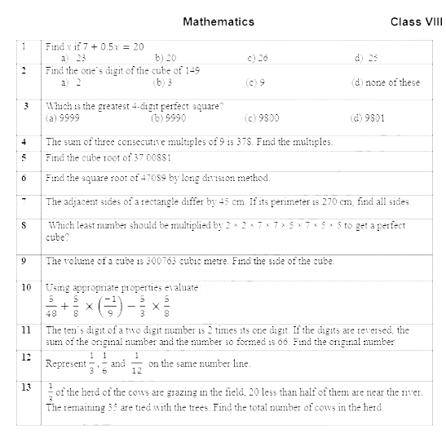
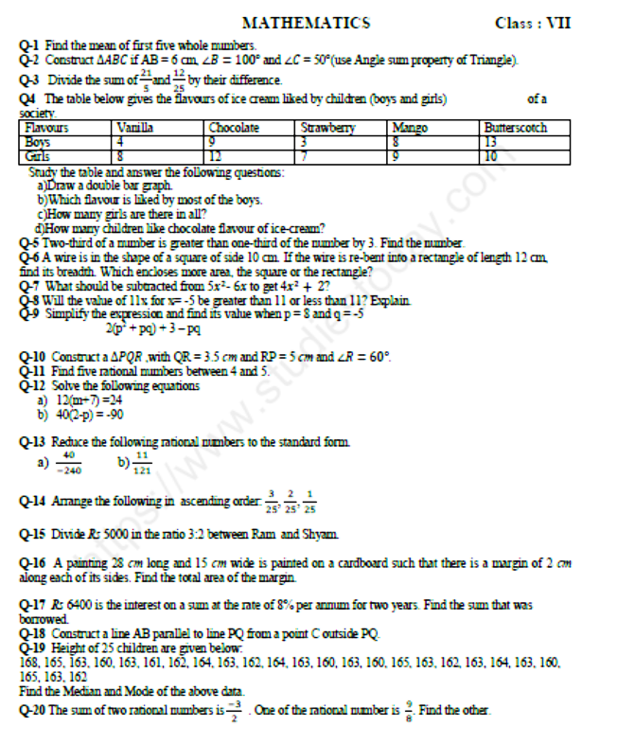
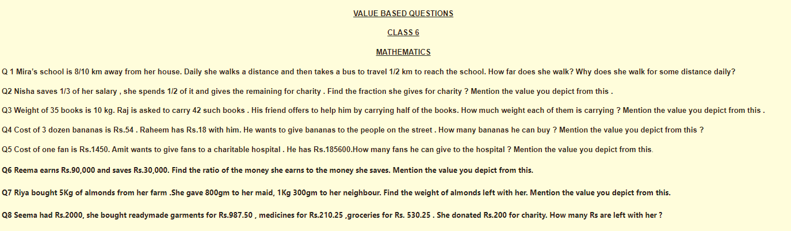
PRACTICE SHEETS

Slide 12
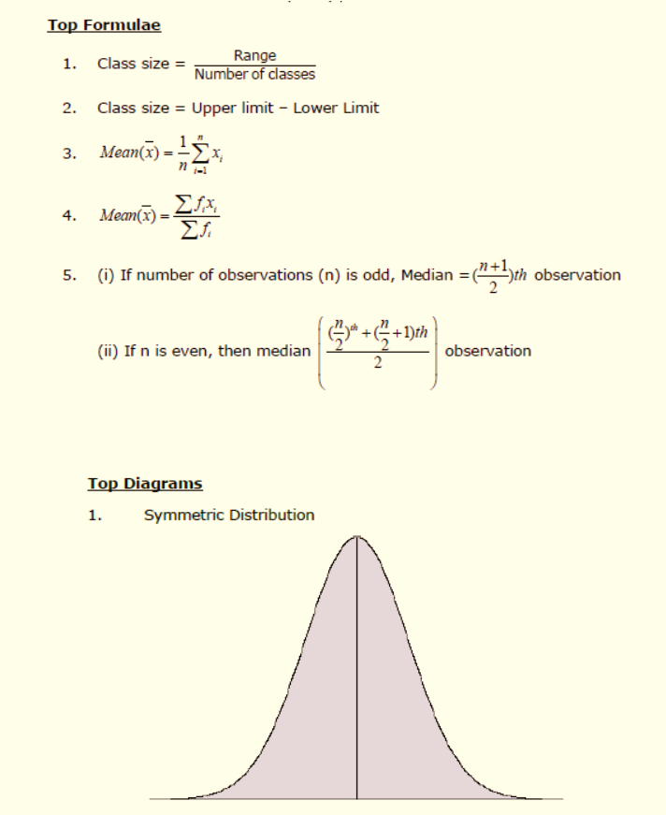
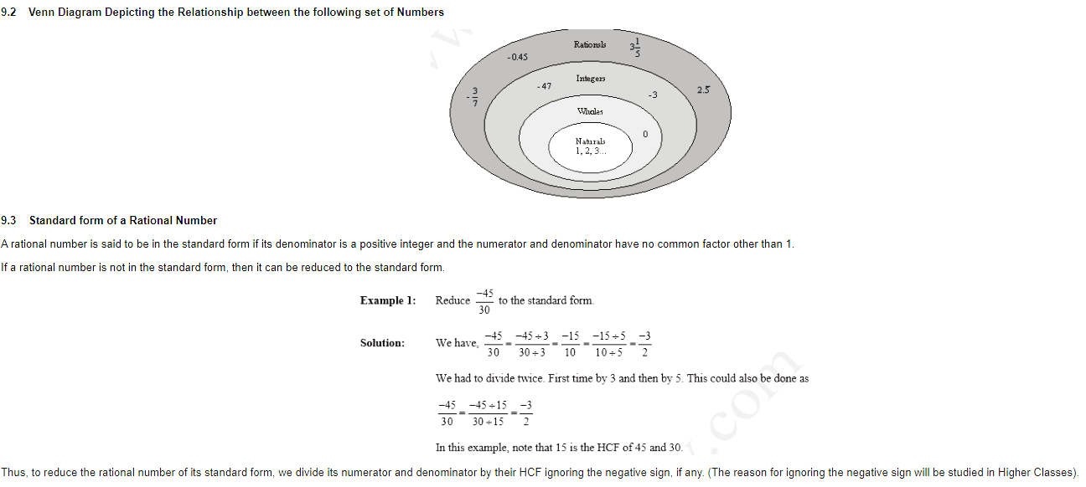
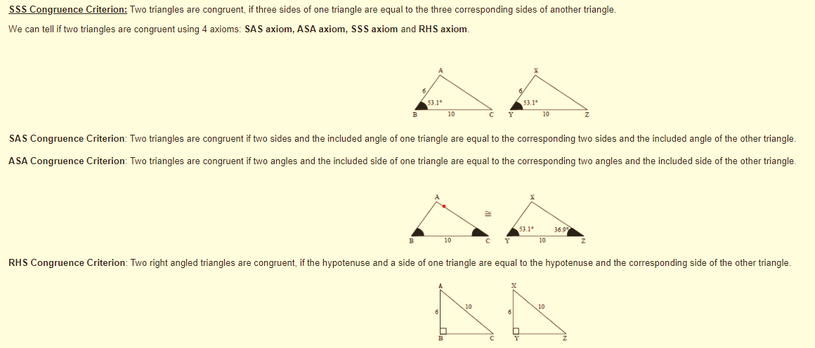
REVISION NOTES

Slide 13
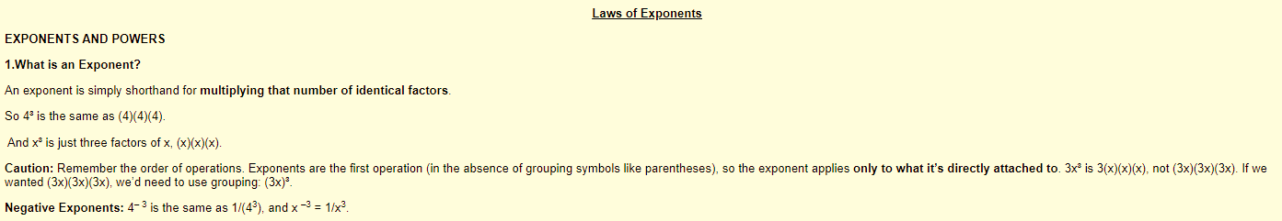
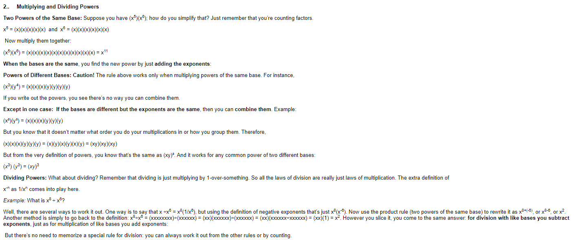
REVISION NOTES

Slide 14
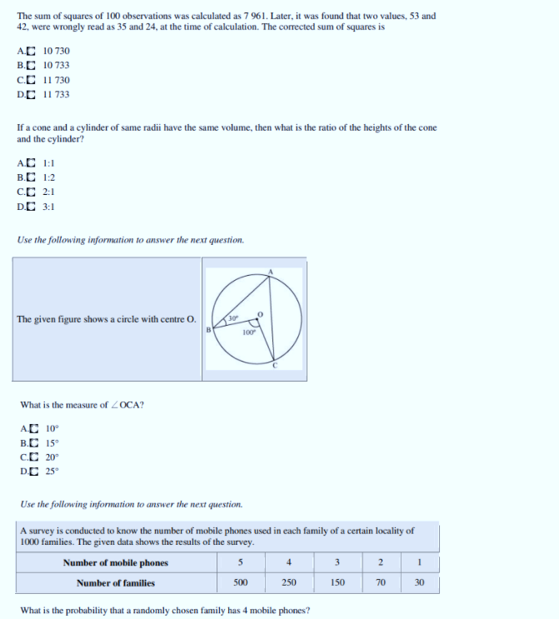
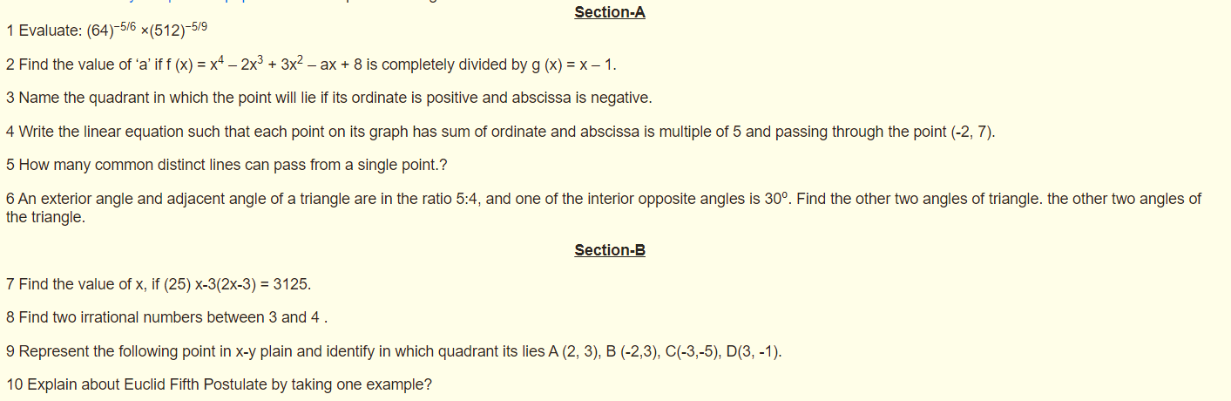
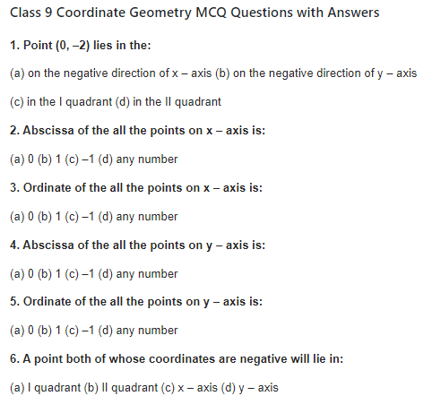
ASSESSMENT TESTS

Slide 15
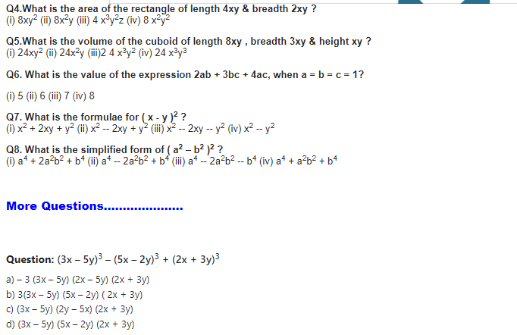
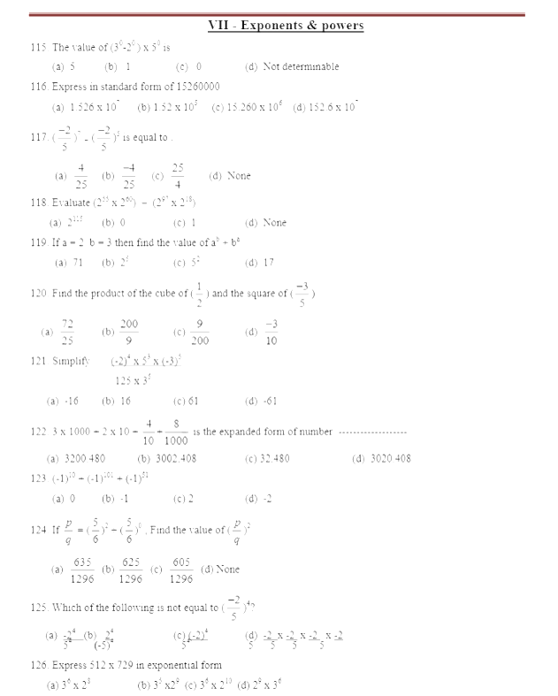
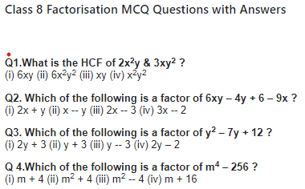
ASSESSMENT TESTS

Slide 16

GOOD WISHES

